Slide 1
COVID-19 APP TRACKING
Justin Andrews
Bryce Cole
Victoria Jordan
Jacob Preseau
Chandra Teja Tiriveedhi

Slide 2
AGENDA
001
002
003
004
PROJECT INTRODUCTION
NEW FEATURES
LATEST IN RESEARCH
FUTURE PLANS

Slide 3
001
PROJECT
INTRODUCTION

Slide 4
RECAP- LAST SEMESTER
Continuation of last semester’s project
Vision: To create an app that allows users to create an ego network of their friends and use that ego network to aid in tracking COVID-19 cases and spread.
Technologies: Dart, Flutter

Slide 5
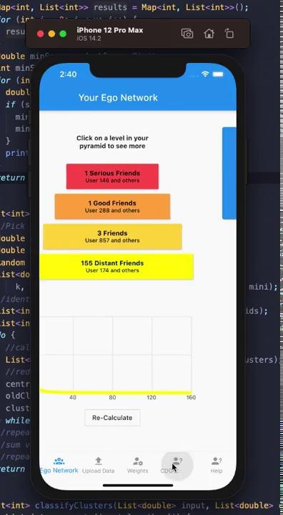
DEMO
VIDEO

Slide 6
SPRINT 1 GOALS
Fix some of the known bugs in our app
Begin to improve upon the design and beauty of the app
Investigate the ability to use location, call, and message data to know if we will be pursuing those paths further throughout the semester.
Implement basic AI to detect positive or negative emotion in messages.

Slide 7
NEW FEATURES
002

Slide 8
CDC GUIDELINES PAGE [Teja]
Added the page with the CDC precautions as a starter to get used to Flutter
Need to develop this further by having demo videos of CDC guidelines/precautions
Would be good to have the vaccination rates and case statistics

Slide 9
BUG FIXES [Justin]
Uploading a data source to the app now redirects the user back to the home page instead of the upload page
Fixed various alignment and consistency issues
Worked on fixing a bug makes it difficult and unintuitive for the user to unlink their data source from the app. This will be continued next sprint because this bug will require a major rework in the way the upload page works.
Found new bugs and added them to the project backlog list

Slide 10
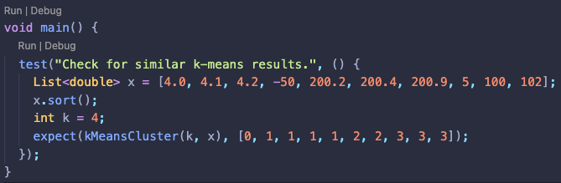
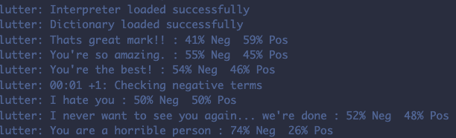
Bryce
K-Means Clustering
Emotion Judging with NN
Need a way to find groups in result graph.
K-Means Clustering would work but no 1D solution works for dart.
Had to implement my own, turned out great.
Emotion plays a large role in finding Dunbar’s number
However judging emotion from text is hard, sometimes even for humans.
My solution is using a pretrained (not my own) NN to add depth to algorithm.

Slide 11
003
LATEST IN RESEARCH

Slide 12
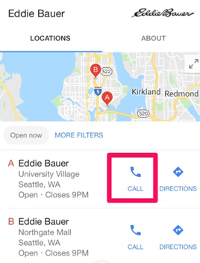
CALL & MESSAGING DATA RESEARCH [Victoria]
“Click to call” features - Google’s Call Tracking
SMS Backup
Use GMail/IMAP to create SMS and call logs over the network
Future Plan: Focus on call logs for sprint 2

Slide 13
LOCATION DATA RESEARCH [Jacob]
Conclusion: the only location data explicitly available to us is that of the user
However, we can do more with just that
Idea for future Sprints: Scan recent posts for visited locations and reference a database with COVID-19 statistics to identify potential risk of exposure

Slide 14
004
FUTURE PLANS

Slide 15
SPRINT 2 GOALS
Continue to work on bug fixes as well as polishing the app to look more professional
Continue working on the AI Algorithm for detecting emotions
Add call and location data as their own data sources within the app

Slide 16
QUESTIONS?

